Slide 1


HACK-O-PROTOQUEST 2022
APNA BUSINESS
PRESENTATION BY INNOVATIVE MIND

Slide 2



Slide 3
PROBLEM STATEMENT
Many of the times youths have a thought of creating or establishing something of their own, but due to lack of good mentorship, peer support and a good understanding of resources they fail to do so.
They can do something innovative if they get proper guidance, a good community of people and infrastructure.
Sometimes it may also happen that they have an idea, but that idea is not a
full fledged idea , so there is a possibility that the person leave that idea even though his idea can led the society towards development.
So , as to solve these issues, we (TEAM-INNOVATIVE MIND) has come up
with an idea that is a web application with the name APNA BUSINESS.

Slide 4
IDEA/ PROPOSED SOLUTION
WE HAVE PLANNED TO MAKE AN APPLICATION WHERE INDIVIDUALS OR GROUP OF INDIVIDUALS CAN GET HELP IN TURNING THEIR INNOVATIVE IDEAS INTO REALITY. THE UN- SUSTAINABLE DEVELOPMENT GOAL WE HAVE CHOOSEN IS INFRASTRUCTURE, INNOVATION AND INDUSTRY.
THE PROTOTYPE SHOWN IS JUST A KICK OFF TO OUR REAL APPLICATION, ITS NOT THE COMPLETE APPLICATION.
MANY INDIVIDUALS HAVE SO MANY INNOVATIVE IDEAS INTO THEIR MIND WHICH THEY CAN NOT VISUALIZE PROPERLY OR NEED ANY MENTORSHIP OR EVEN SOMETIMES THEY NEED A PARTNER TO WORK WITH.
APART FROM THAT, THIS APPLICATION WILL PROVIDE A PATHWAY TO SEARCH FOR A BUSINESS IDEA IN FIELD OF –TECHNICAL BUSINESSES, COMMERCIAL BUSINESS ETC. WE ALSO RECOMMEND SOME GOOD STARTUP AND ENTREPRENUERIAL BOOKS AND
TRAINING SESSIONS THAT CAN HELP USER ESTABLISH THEIR STARTUP IN A MUCH BETTER WAY.

Slide 5
WHY A PERSON WILL GUIDE YOU?
THIS APP WILL GIVE THE MENTOR A REWARD OR STAR AFTER 10 SUCCESSFUL COMPLETION OF GUIDANCE AND THOSE STARS CAN BUILD THEIR PROFILE IN TERMS OF EXPERIENCE.
FUTURE SCOPE-
FUTURE SCOPE OF THIS APPLICATION INCLUDES HELP IN GETTING YOUR INFRASTRUCTURE AND WORK IN YOUR PREFFERABLE INDUSTRIES.

Slide 6

PROTOTYPE

Slide 7



H OM E
SE R V I CE S
A B OU T U S
CON T A CT
APNA BUSINESS
change your ideas into reality

Slide 8

PITCH IN YOUR IDEA-
Find Partners
Find Guidance

Slide 9
Services:
ALL BUSINESS IDEAS
BUSINESS IDEAS
ENTREPRENEUR TRAINING
PARTNERSHIP & MENTORSHIP
RECOMMENDED BOOKS
TECHNICAL
COMMERCIAL
VERBAL OR WRITTING SKILLS

Slide 10









Earn money with Hotmart: How to become an affiliate
How to get your first crypto coins for free
Click & Sell Photos
Create & Sell Webinars
Get Paid by Managing Social Media Pages
Work as freelance in Workana
Use an Online Franchise
Start a Youtube channel
Offer Search Engine Optimization Services

Slide 11
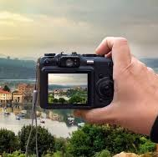
CLICK AND SELL PHOTOS
No Special Skill
Suitable For
People Who have the passion for Photography.
Skills Required
Ability to take versatile and creative photos.
Time Required For Starting Photography
If you are an experienced photgrapher you can start almost Instantly. If you are new you might need time to learn photography. Learning time completely depends on how quickly you grasp the concepts.
How To Monetize
Sign up at the following websites, upload your photographs and start learning money once people start buying them. But remember, creativity is really necessary for photography.
You will have to bring more professionalism and creativity in your photographs to start earning a good income. Merely talking random photographs from your cell phone or a digital camera is not going to work here.
Shutterstock.com GettyImages.com Stock.adobe.com Dreamstime.com

Slide 12
RECOMMENDED BOOKS
The Startup Owner’s Manual
Zero to One
Leading at the Speed of Growth Founders at Work
The Lean Startup
Mastering the VC Game
Start Something That Matters Never Too Late to Startup

Slide 13

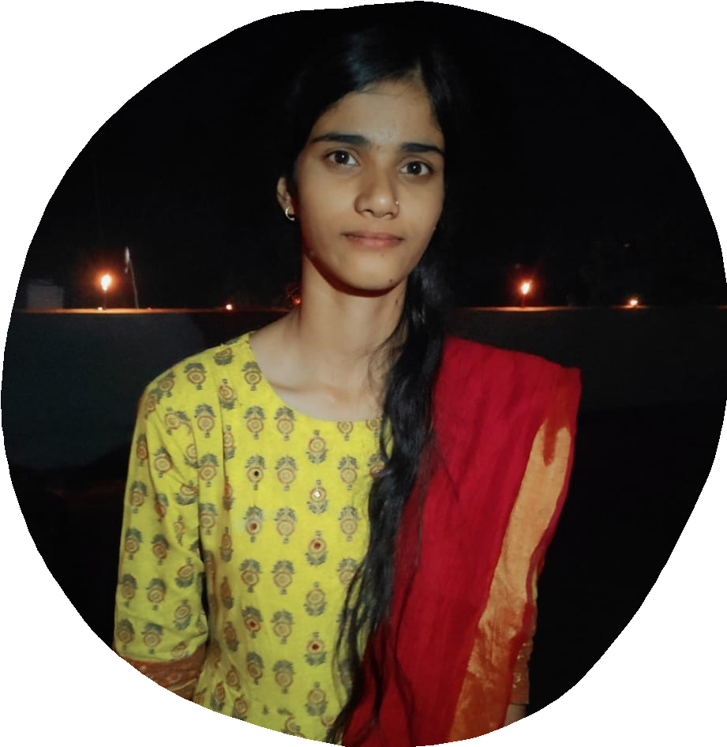

NASREEN
ANAM
JAHNAVI

Slide 14
Thankyou!

